Slide 1
Smart Washroom/ Bathroom for Senior Citizens Prone to Heart Attacks

Slide 2
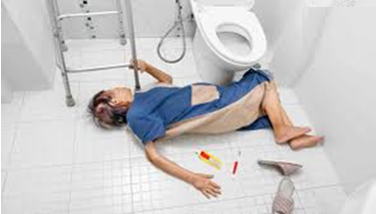

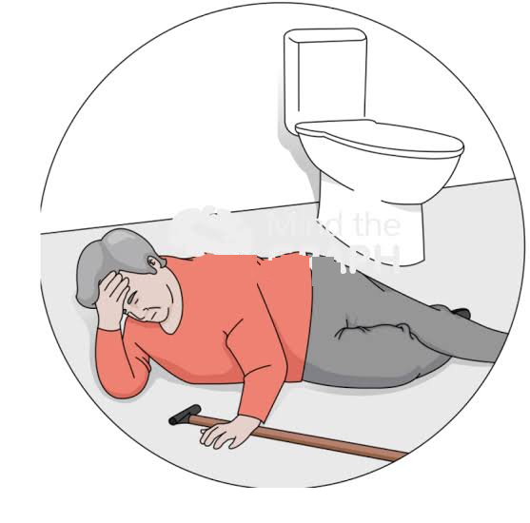
Smart Washroom/ Bathroom for Senior Citizens Prone to Heart Attacks

Slide 3
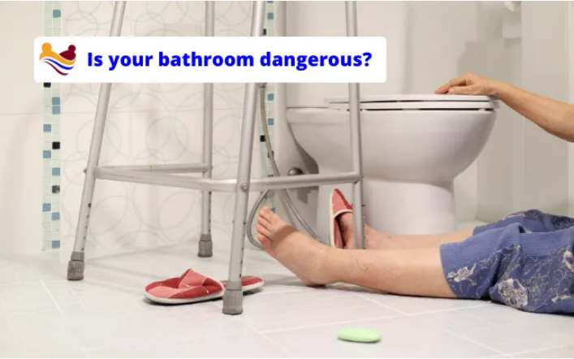

Slide 4
INTRODUCTION
Old age is a sensitive phase; elderly people need care and comfort to lead a healthy life without worries and anxiety. Lack of awareness regarding the changing behavioral patterns in elderly people at home leads to abuse of them by their kin. It is true that the older a person gets, the weaker their body system becomes. As a result, older people are more susceptible to illnesses. Blood pressure, heart failure, diabetes, and arthritis are just a few ailments that older people may get exposed to if they are not suitably cared for in their old age.

Slide 5
Problem/ Common Issue
Many time we heard that some ones relative went to washroom / bath-room in the morning and half or one hour later his home members tried to call him/her then they found he/she was not responding. After broking the door they found he/she was dead due to heart attack. Medically it is proved after severe heart attack if patient is treated within an hour he/ she can cure. But, if such patient stuck in the washroom/ bathroom, which is locked from inner side, home members unaware of the situation and they are unable to support to the patient for treatment.

Slide 6
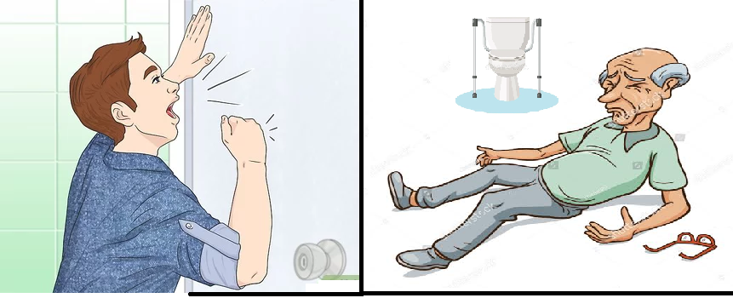
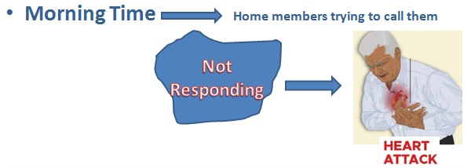

Slide 7
Best Feasible Solution:-
Now technology has been changing drastically. Homes are becoming smarter and smarter. Many of houses adapted security systems to avoid theft and energy saving circuits to reduce light bills. Many of homes, malls, theatres, using motion sensors that sense the movement of person, if there is no movement that systems turning of electrical appliances such as light, fan, AC, climber, etc.
Similarly, if we use motion sensors in the washroom/ bathroom and if we set particular time delay and after that time delay:
If movement doesn't found, alarm should start so that other home members can aware about the situation in Washroom/ Bathroom. They can break the door and treat the person within time.
If movement doesn’t found and alarm started and person in the bathroom is in safe mode he/ she can press push button to indicate that there is no any hard situation.

Slide 8
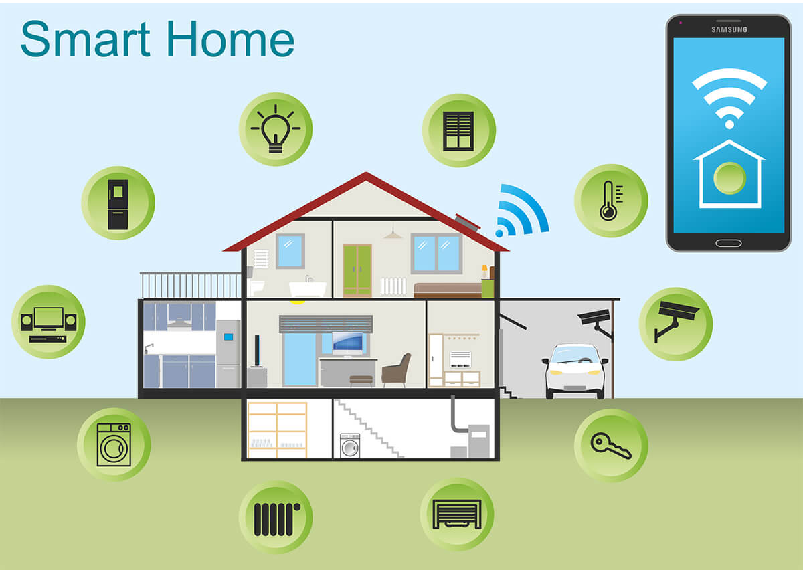

Slide 9
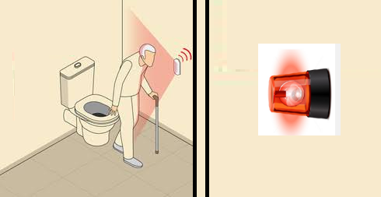
Solution 1:-
If Movement Doesn't Found Alarm Blown

Slide 10
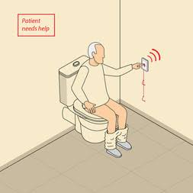

Solution 2:-
Panic Switch Alarm Blown

Slide 11
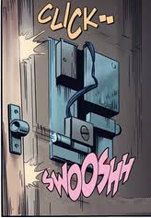
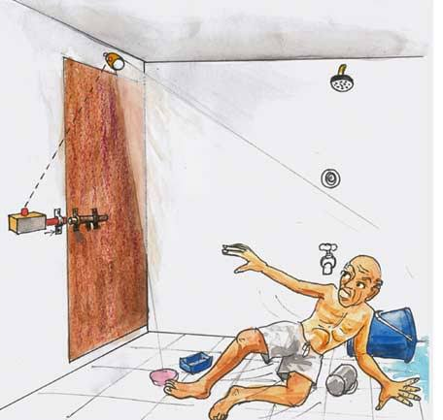
Solution 3:-
Panic situation
No Movement Detection > 2 mins
Alarm Ringing

Slide 12
Components Required:
Arduino Uno
PIR (Passive Infrared) Sensor
Buzzer
Momentary Switch
Jumper wires
Breadboard (optional)

Slide 13
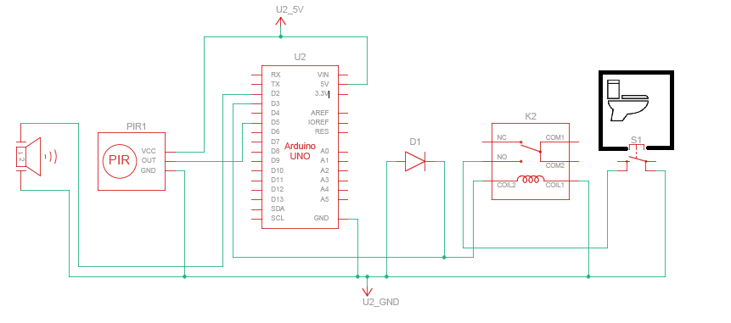
Circuit Diagram
This specialized smart bathroom project, designed with the unique needs of senior citizens prone to heart attacks in mind, utilizes Arduino Uno, a Passive Infrared (PIR) sensor, a buzzer, and a switch. The primary goal is to enhance bathroom safety and provide immediate assistance in case of a health emergency.

Slide 14
Explanation with Consideration for Senior Citizens
1. The project's primary objective is to ensure the safety of senior citizens who are prone to heart attacks. The system activates when the senior citizen enters the bathroom.
2. If there is no movement detected for 2 minutes, the system triggers a loud alarm. This feature serves as a safety net to call for immediate assistance in case of a health emergency, such as a heart attack.
3. If person in was still due to other reason for 2 min and if he/she came to know alarm is ringing then he/ she can immediately stop the alarm by pressing internal switch indicating that there is no any hurdle.

Slide 15
By tailoring this smart bathroom project to the specific needs of senior citizens prone to heart attacks, you can help provide a safer and more secure bathroom environment for this vulnerable demographic.

Slide 16
THANK YOU!!

